Slide 1
JP · TAP THAT · THE PIVOT
The Pivot
From vanity to sanity. A strategic evolution, not a rebrand.
6 September 2026
Notes:
The plan is sound. The shape is the problem, and that is a much better problem to have. Everything after this is about focus.

Slide 2
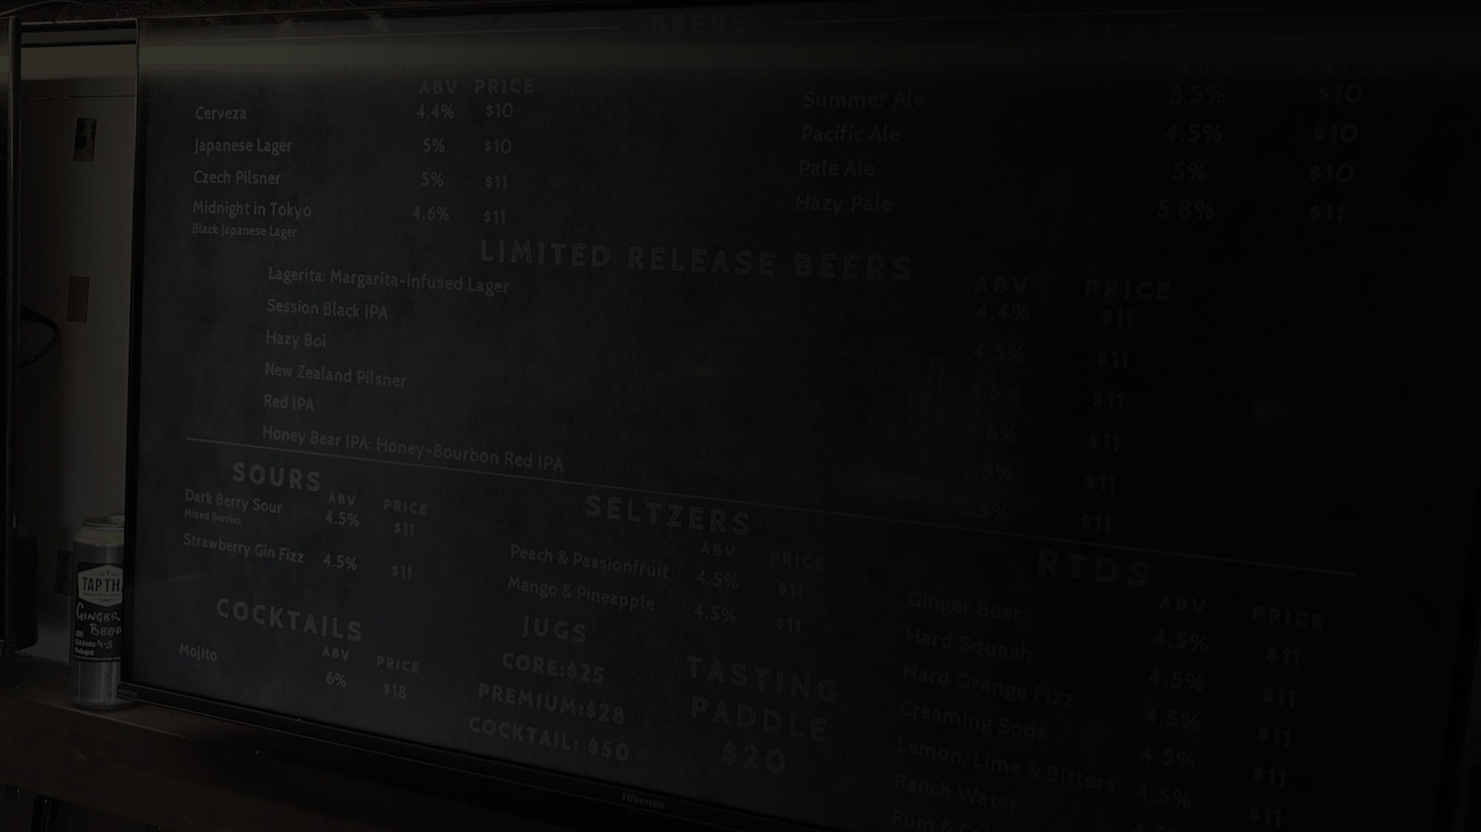
PART 01
Context.
What the numbers and the site visit actually say.
Notes:
Part one is what the numbers say, and what they do not say.

Slide 3
PART 01 · CONTEXT
The overall plan is sound. Focus is the part that is missing.
01
The strategy is sound. The shape is not.
Comprehensive, and Justin's mental model that everything feeds refills is right. But it reads as AI theoretical. Too much equivalence, too many directions, and its own best insights are buried.
02
Two business units cancelling each other out.
Thought to be complementary, in reality pulling opposite ways. A good refill business takes traffic out of the Tap Room, which means more spend to replace it at a high cost per customer.
03
The weakest unit is getting the support.
Refills are at MVP, and only refills, and only beer. Marketing's time goes to propping up the unit that does not work, at the cost of the ones that do.
Notes:
The second finding is the whole deck. The two units cancel each other out.

Slide 4
PART 01 · CONTEXT
Three more, and the last one is the reason to move now.
04
The offer is good. The stars cannot shine.
We suspect a long tail of beer options is driving cost of goods. We also think it is causing choice paralysis at the point of sale.
05
Chasing two rabbits, catching neither.
For all the right reasons, marketing explores an idea, quits, and moves on. Nothing gets the run it needs to prove itself either way.
06
In danger of dying with a beautiful corpse.
Running a brewery is hard. Hospitality is harder. Both on a skeleton staff is unreasonable. Permission is needed to reshape the business.
Notes:
Six is the one that gives permission to change the shape of the business.

Slide 5
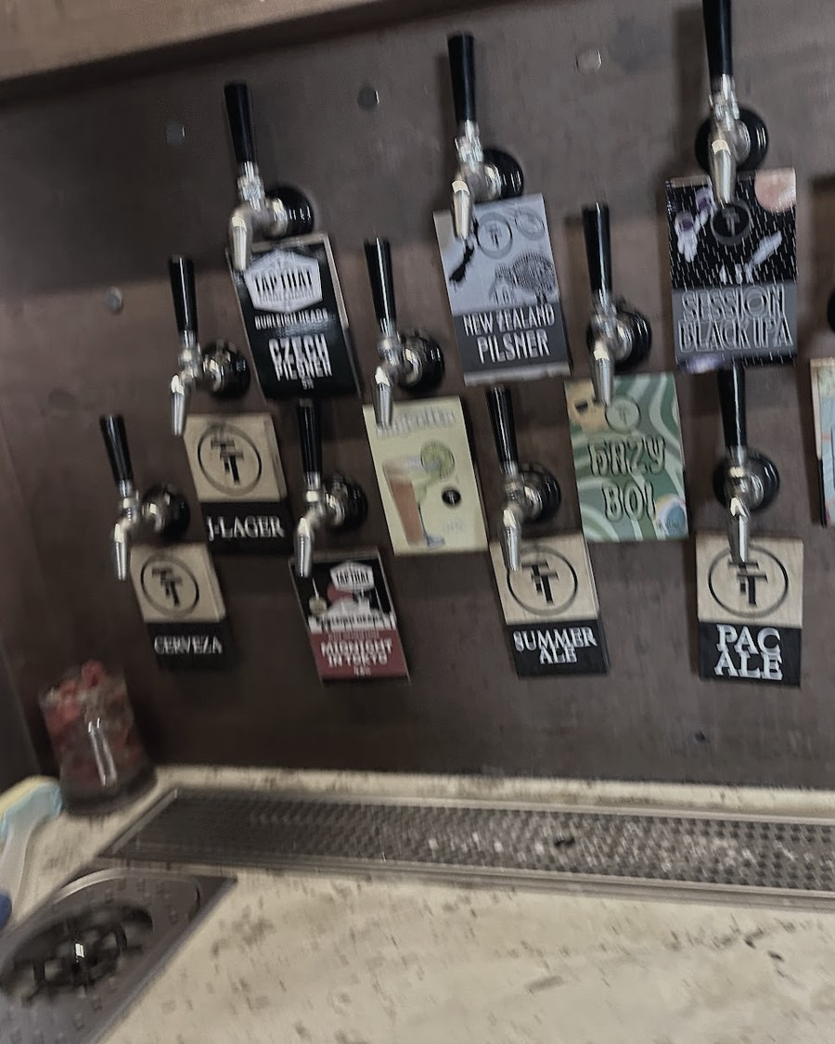
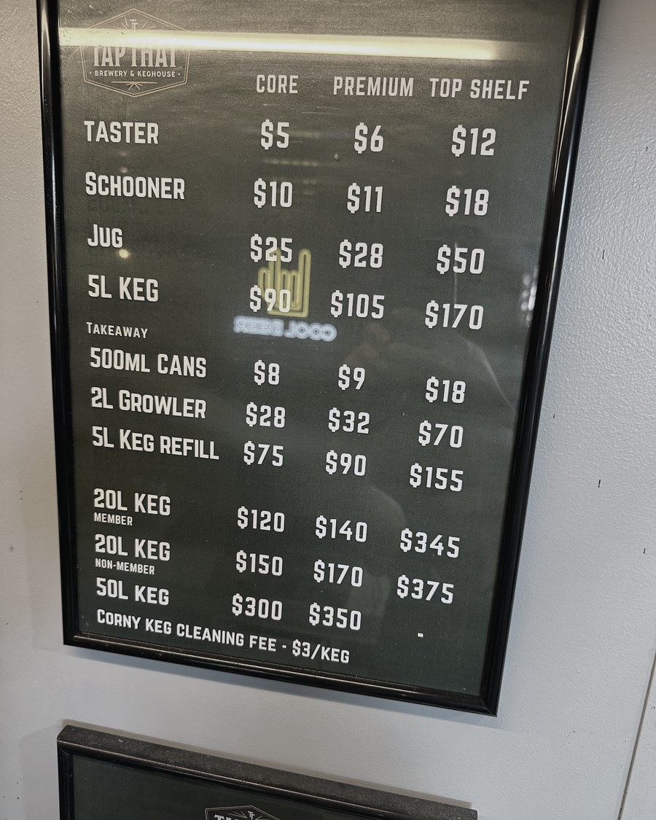
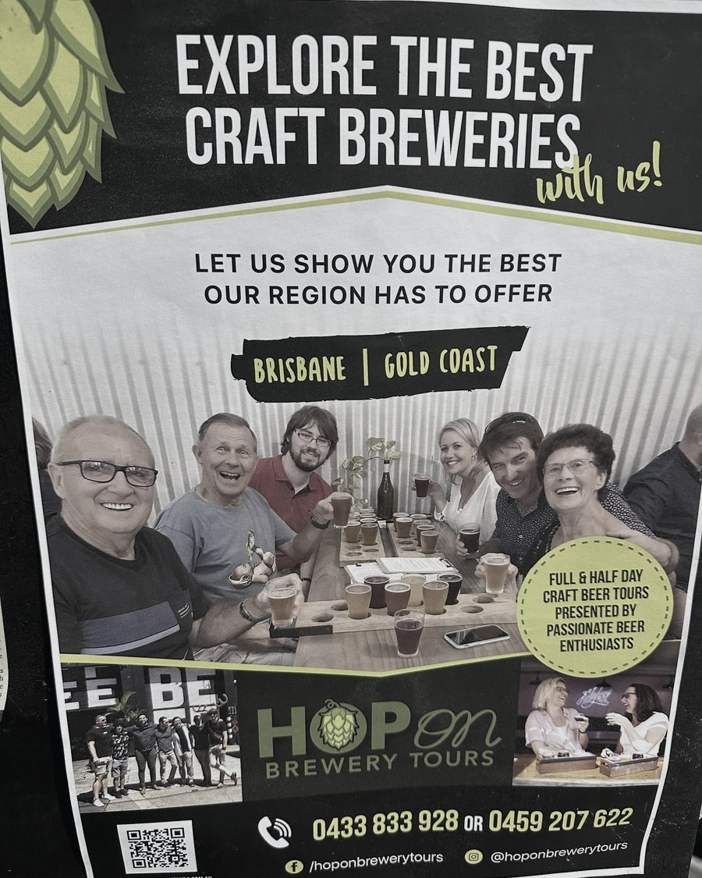
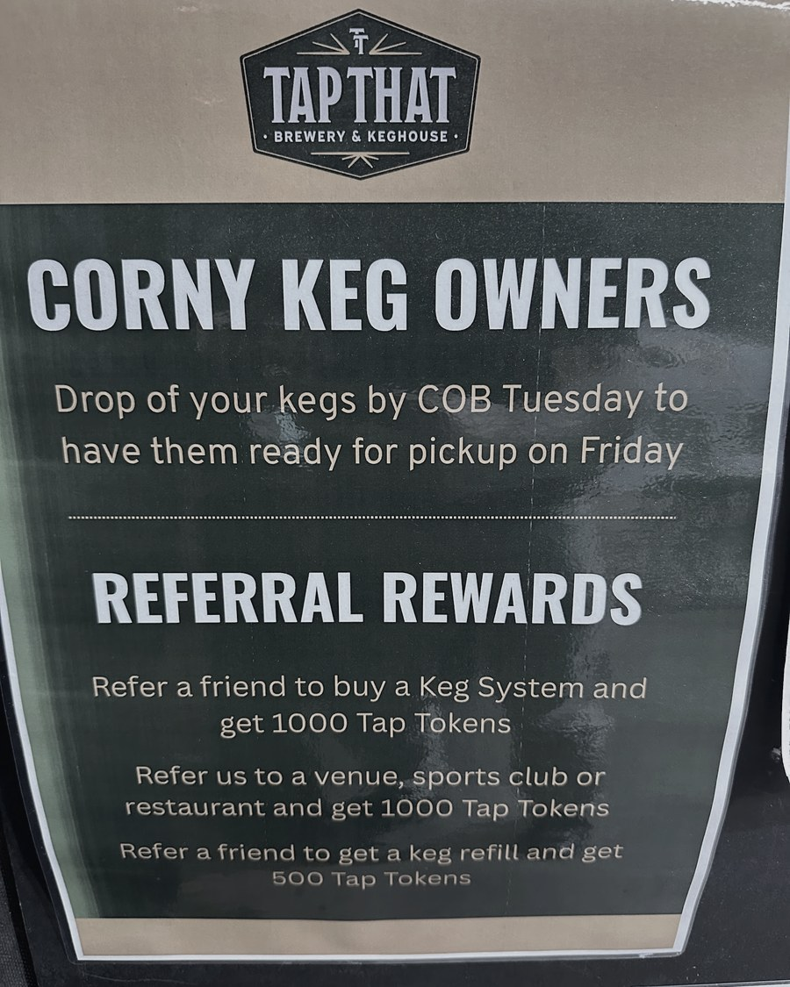
PART 01 · CONTEXT
The room the strategy has to work in.
27 taps, and a third of them are not beer
The price board, as it stands
The tour circuit already comes past
Referral rewards, already running
Site visit, August 2026. Twenty-seven photographs on file.
Notes:
Everything in this deck comes out of this room. Worth a beat before the numbers.

Slide 6
PART 01 · CONTEXT
Tap Room is vanity. Refills are sanity.
96-113
56%
20%
Active refill customers, ordering repeatedly. That is MVP status, and it was reached without a push.
of refill customers bought their tap system somewhere else. The refill proposition is already validated.
of system buyers are said to have visited the Tap Room. That is correlation, not proven causation.
The Tap Room works as an event and function destination. It does not work as a walk-in, because the footfall is not there. The task now is to edit the losers hard and invest in what is proven.
Notes:
96 to 113 active refill customers, reached without a push. That is the proof the model works. The 20% is the number to be careful with.

Slide 7
PART 01 · CONTEXT
Two things to hold on to before anything is decided.
Who is the real enemy?
Handle the census with care
Overpriced pubs. Not the duopoly, not A&A, not the keg delivery operators. Speak in unit economics everywhere, and do not get pulled into a keg price war you do not need to fight.
49 people, forced-choice answers. People do not always know, or say, why they buy. Status, wanting to be seen as successful, compensating for something else. Real drivers, rarely spoken. Useful colour. Not a strategy map.
Notes:
The census is 49 people answering forced-choice questions. It is colour, not a map.

Slide 8
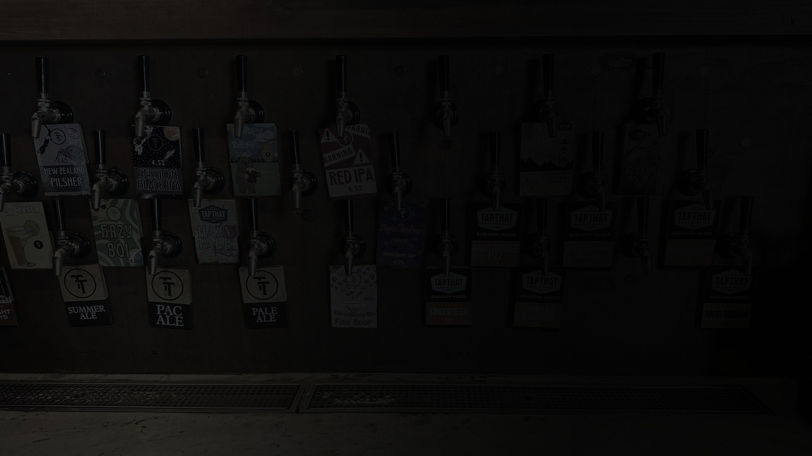
PART 02
Direction.
Ten moves. Five of them come first.
Notes:
Ten moves. The first five change the shape of the business, the rest extend it.

Slide 9
PART 02 · DIRECTION
Get the core right, then go for more.
MOVE | THE SHIFT | PROOF | FIRST STEPS
01 Tap Room: pause and pivot | Pause walk-in trading. Go all in on destination demand. | Event and function nights are already profitable. | PR to tourism, event and wedding planners. Own the tour circuit: Urban Legends booking tool, Pineapple Tours, the Crafted award. Ticketed events and collabs. Party rental, with minimum-guarantee kegs covering the rental cost.
02 Convert the owners already sold | Objections are already overcome for existing kegerator owners. | 56% bought their system elsewhere. | Harvey Norman gift-with-purchase and point-of-sale tie-up, plus the buyer database. Buy Kegland and corny keg owner databases. Official Benchy partnership. Co-branded outdoor BBQ and system bundle.
03 Remove all friction in refills | Every extra step in the refill process costs a sale. | 10% reorder monthly, 40% far later. One clock fails both. | Free delivery always works, and margin comes back in dollars, not percent. Replace the blanket 90-day SMS with consumption-triggered reminders. Lead on no CO2, pick up and go. Simplify membership. Get Justin off the bar and onto the road.
04 Rationalise the range | Create hero products that carry social proof, and cut the non-productive tail. | About 19 brew choices loses both curation and best-in-class. | Deeper product marketing on the brews that remain. Social proof cues such as most popular. Free the shelf space and the brewing time for the heroes.
05 Ride the wellness wave | Also the way back to lapsed customers. | 40% of lapsed customers cite cutting back. | Low, non-alcoholic, low-carb and protein range. Wellness influencer collabs, amplify or co-develop. Reframe for the cutting-back cohort as a healthier alternative, not less beer.
Notes:
Moves one and three are the ones that change the shape of the business. Everything else waits on them.

Slide 10
PART 02 · DIRECTION
Once the core is running, extend it.
MOVE | THE SHIFT | PROOF | FIRST STEPS
06 Full press on wholesale | Resourced, structured and measured. No more falling through the cracks. | One wholesale account is worth about ten households. | Hire a full-timer or an agent. Set targets and KPIs. Custom systems for sporting clubs, with minimum-guarantee kegs per season. Move rigs from footy to cricket for year-round occupancy.
07 Design for her | Covered is not the same as catered for. | The interest in the brews is real. The range does not reflect it. | Romance the RTD properly. Build the hydration story through the wellness and light range. Products she is proud to serve. Systems designed to sit in eyesight at home.
08 Personalise comms and lifetime value | This needs a process, not a message. | Buying cycle: about 60% within three months, 40% longer. | Track consumption to predict the next refill. Re-engage lapsed customers by actual reason, cutting back versus forgot. Trigger-based outreach, not calendar-based. Personal details: anniversaries, footy finals.
09 Make the kegerator worth writing about | Turn the system itself into demand. | 1,000 giveaway entries is proven demand. | User-generated content mechanic: tag Tap That, get a discount. Own your keg personalisation, like a whisky bottle. Explore short-term and occasion rental for parties.
10 Package around the duopoly | Locked-in venues still have real pain points. | Contractual lock-in is not the same as satisfaction. | A packaged offer that works around existing contracts. Find the judo move that uses their size against them: no lock-in, profit share, white labelling.
Notes:
Six has the best return per hour once the core five are running.

Slide 11
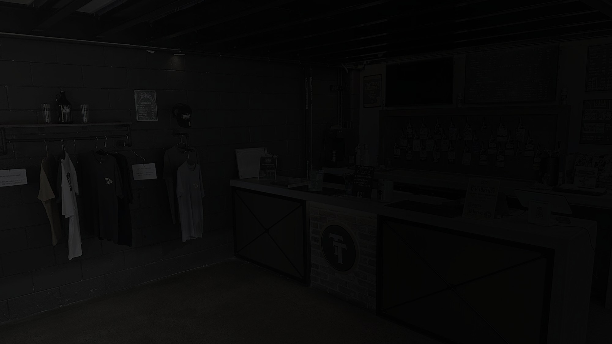
PART 03
Collateral.
What the destination business looks like on paper.
Notes:
The artwork is in Tap That brand, not ours. It is their collateral.

Slide 12
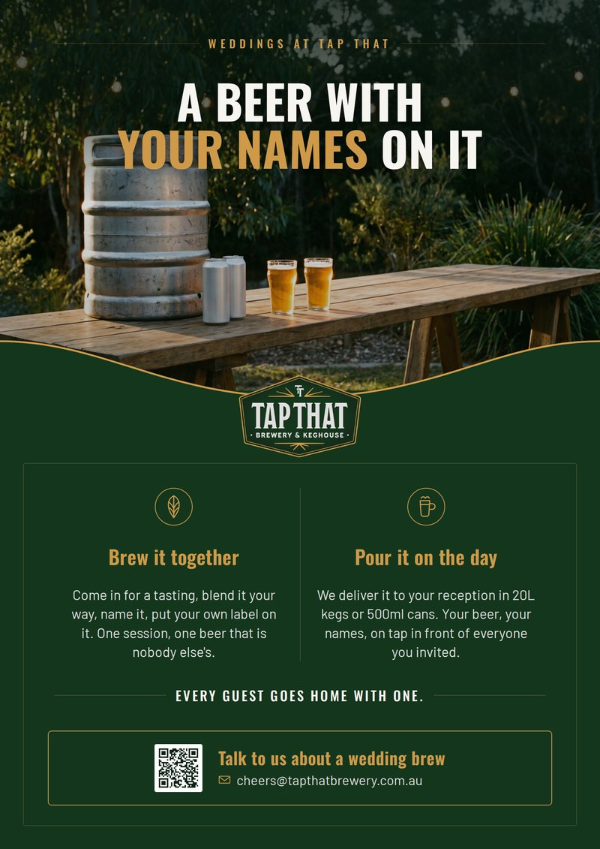
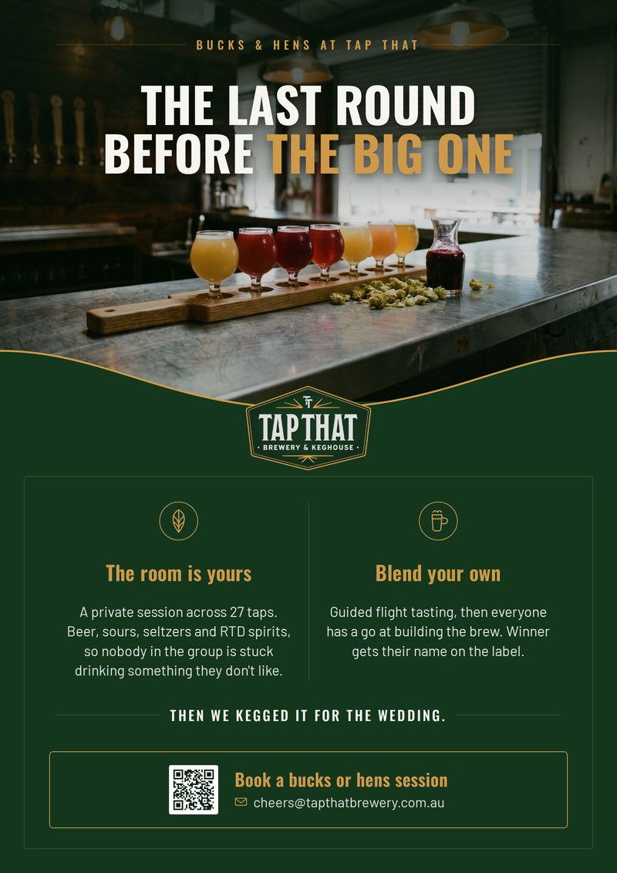
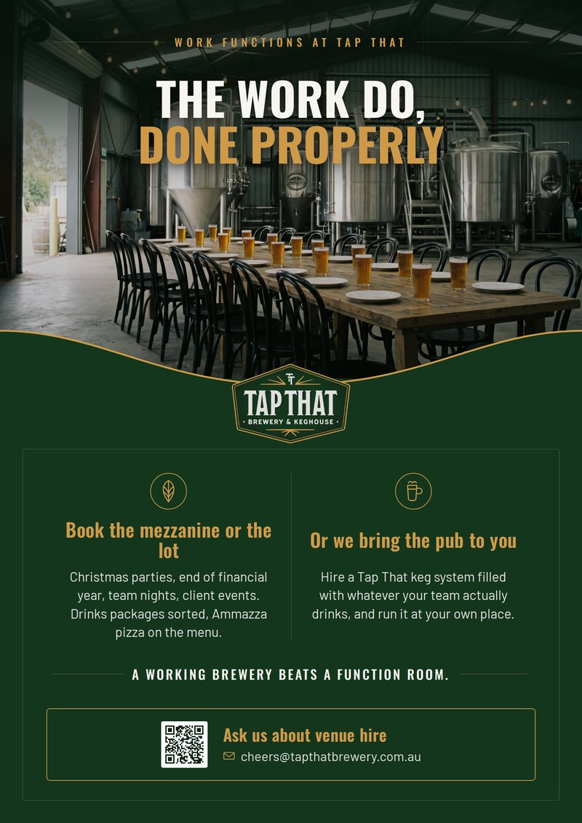
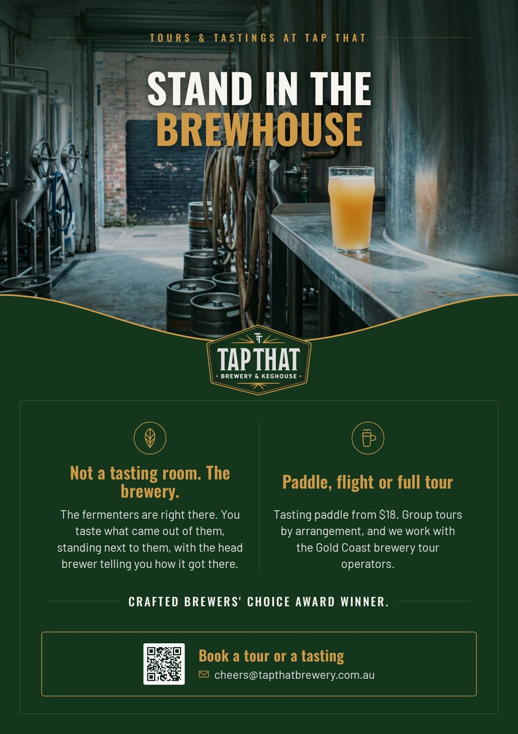
PART 03 · COLLATERAL
The destination business, sold the way the venue already sells it.
Weddings
Bucks and hens
Work functions
Tours and tastings
Format taken from Tap That's own in-venue flyer. The plates are commissioned concept photography: product and room, no people, no set type. A second set built on August site-visit photography is in the folder, for anything that goes out as their own marketing. These sit in Tap That's brand, not ours, because they are the client's collateral. Print-ready A4 at 200 dpi.
Notes:
These replace the two flyer artworks in the earlier draft, which were embedded as EMF vector and render blank anywhere other than PowerPoint on Windows. These are 200 dpi PNG, print-ready at A4.

Slide 13

PART 03 · COLLATERAL
Turning hens and bucks days into wedding day volume.
01
The Tap Room event
Private hens or bucks session. Guided flight tasting across 27 taps, with interactive ingredient blending.
02
Bespoke branding
Co-branded custom label, naming, and beverage style selection: beer, sour, seltzer or RTD spirit.
03
Wedding day reception
Bulk supply delivered in 20L kegs or custom cans for the main event.
04
Take-home compound
Every guest goes home with a branded sample and a QR code.
The artwork, ready to send
THE COMPOUND EFFECT
One private session captures premium venue hire upfront, secures pre-sold volume for the reception, and puts branded product into the hands of every guest.
Notes:
The left column used to be a wireframe of a can and a keg. It is now the flyer that would actually go out.

Slide 14
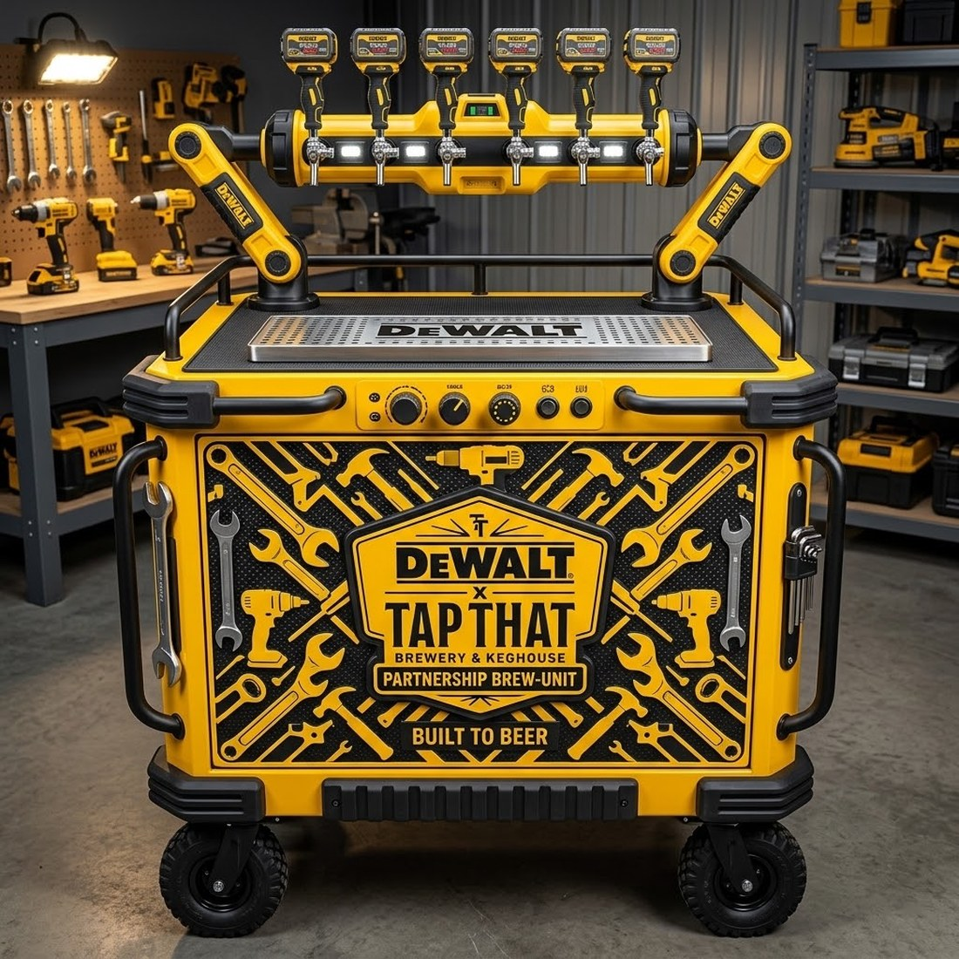
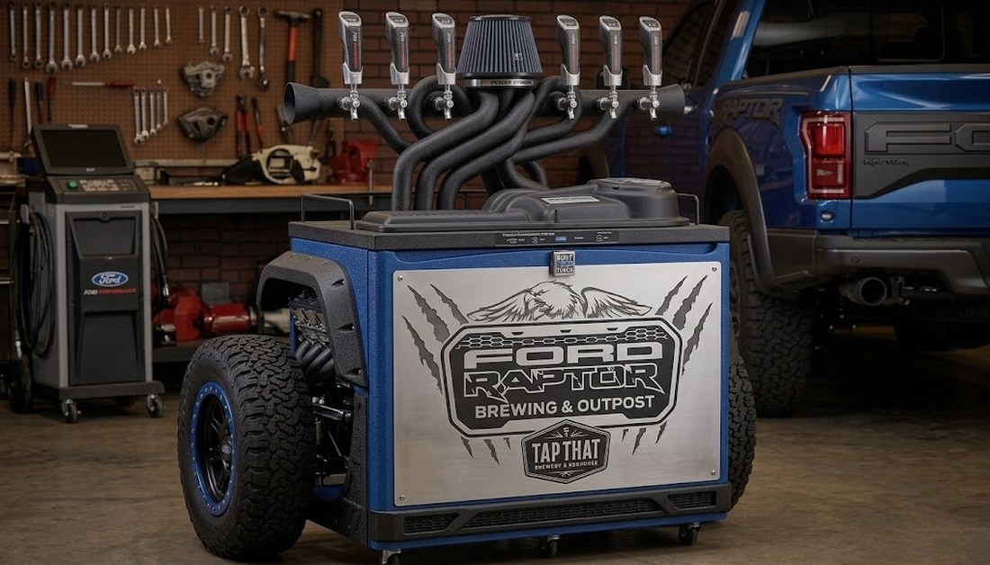
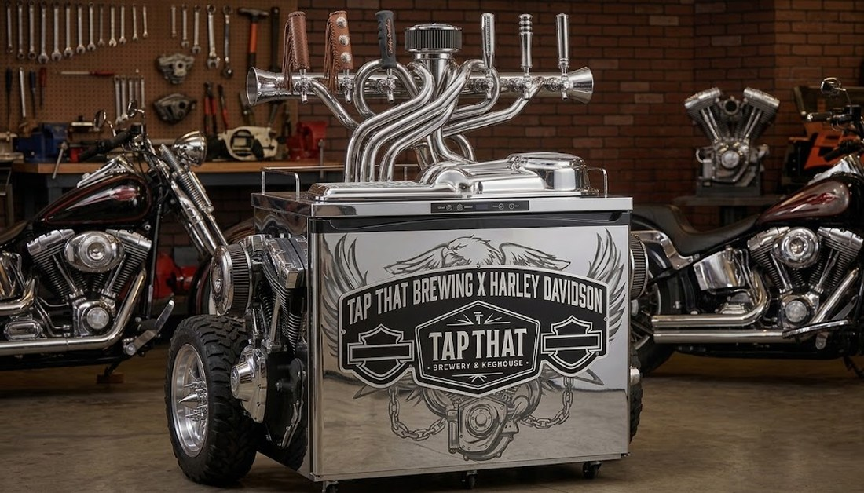
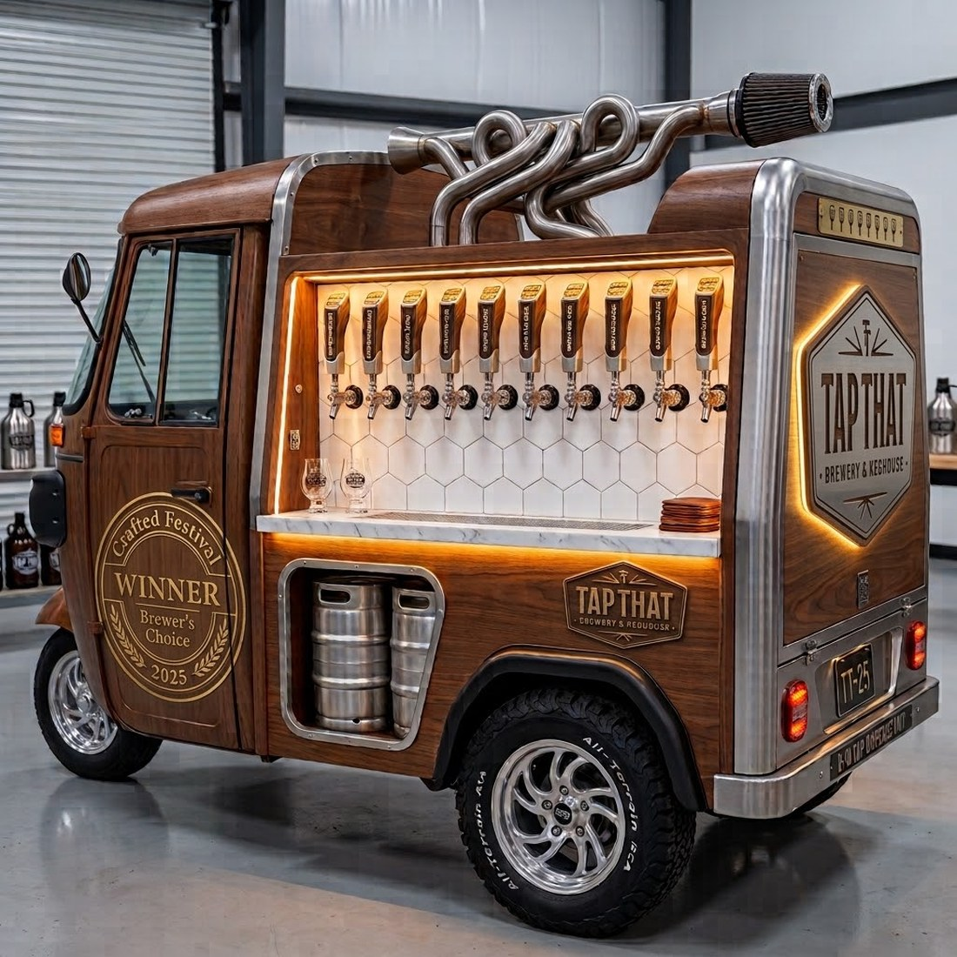
PART 03 · COLLATERAL
What a co-branded system could look like.
Concept renders for discussion. No approach has been made to any brand shown, and none of these marks are licensed. Worth showing for the reaction. Not for anything that leaves the room.
Trade and worksite
Four-wheel drive and touring
Motorcycle clubs
Mobile bar for events
Notes:
Concepts only. Nobody has been approached and the marks are not licensed. Worth showing because the reaction tells you which partnership is worth chasing first.

Slide 15
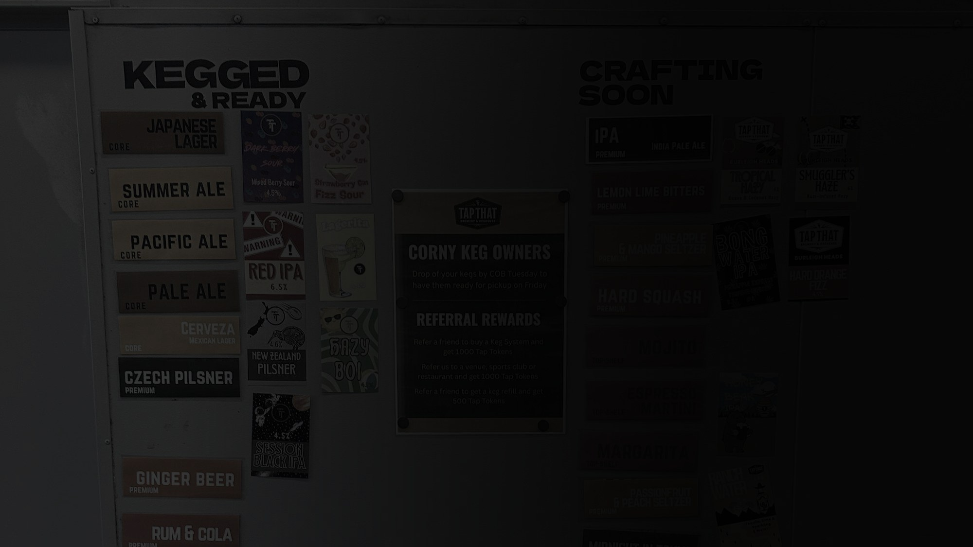
PART 04
Execution.
The small fixes, and where we can help.
Notes:
None of these is a big job. All of them are being paid for daily in conversion.

Slide 16
PART 04 · EXECUTION
Small fixes, disproportionate impact.
Above the fold
No hook, background film cut too fast to read, copy pollution, low-resolution static logo.
Missing proof
The Crafted Brewers' Choice award, the fits-any-system callout and strong reviews are all buried below the fold.
Hierarchy
Four business units treated equally. Prioritise the moments that matter: family, friends, the proud provider role.
Category
Commercial brewer invites mainstream price and product comparisons. It needs an elevated category name of its own.
Channel language
Wholesale should speak directly to restaurants and sporting clubs. Cuisine matching, club-branded kegs, straight to the margin story.

Slide 17
PART 04 · EXECUTION
What we can pick up from here.
FROM THE BRIEF
ALSO WORTH ADDING
Website design optimisation
Trigger-based CRM and lifecycle build, which fixes the 90-day SMS problem
SEO and GEO best-practice implementation
Membership programme redesign
PR outreach to tourism operators and experiential platforms
Wholesale structure and KPI framework
Influencer outreach
Event flyer and campaign artwork, in the format shown
Partnerships outreach and project management
Urban Legends collaborative booking tool
Notes:
Left is what the brief asked for. Right is what we would add. The CRM build has the shortest payback.

Slide 18
Next.
Wording finalised with Christy, then this deck goes to Justin.
Clent Jewell · clent@jewellprojects.com
Notes:
The date on line one needs setting before this goes to Justin.

